Slide 1
PROJECT
WORKHUB
- JINIL THAKKAR

Slide 2
WHAT IS WORKHUB ?
Office Management System
Aims to provide with smoothness in Corporate Operations

Slide 3
Features:
Food Ordering and Management
Meeting Room Scheduling
Seat Reservation
Library Management
Cab Bookings

Slide 4
Tech Stack Used
HTML5
SASS
JavaScript/TypeScript
Angular

Slide 5
Project Structure

Slide 6
Output SnapShots

Slide 7
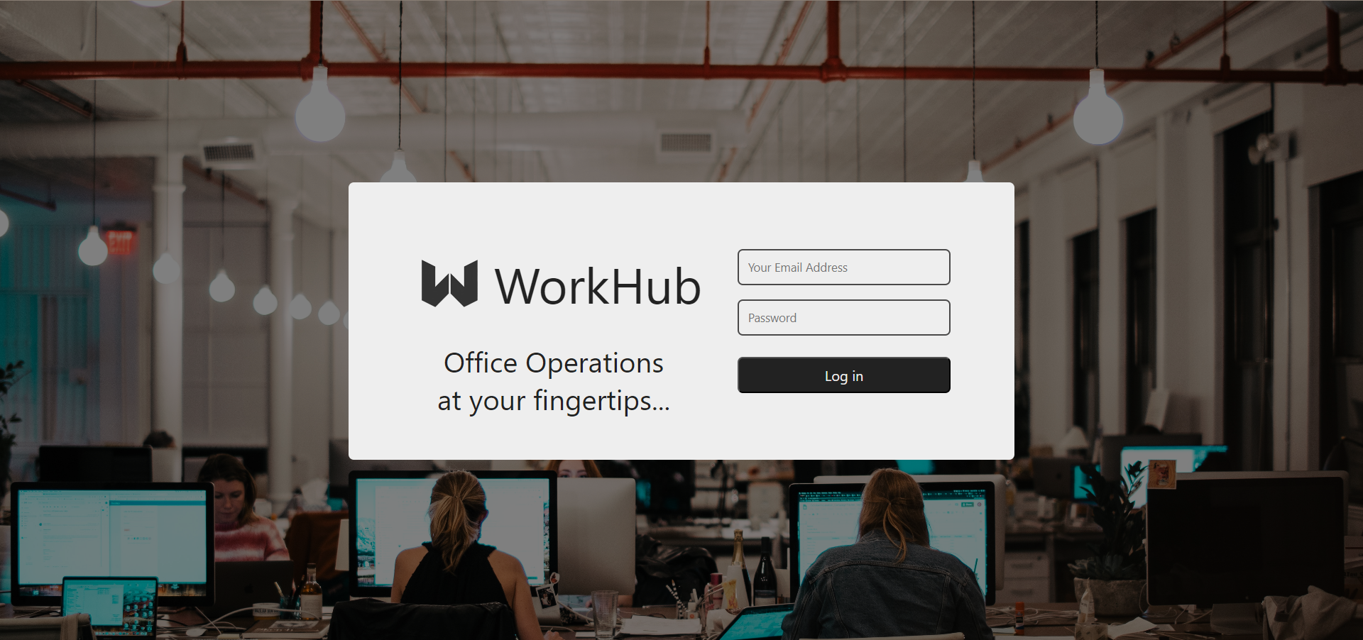
LOGIN

Slide 8
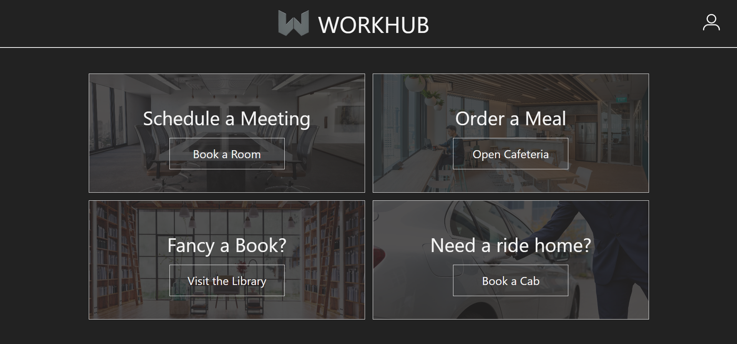
HOME

Slide 9
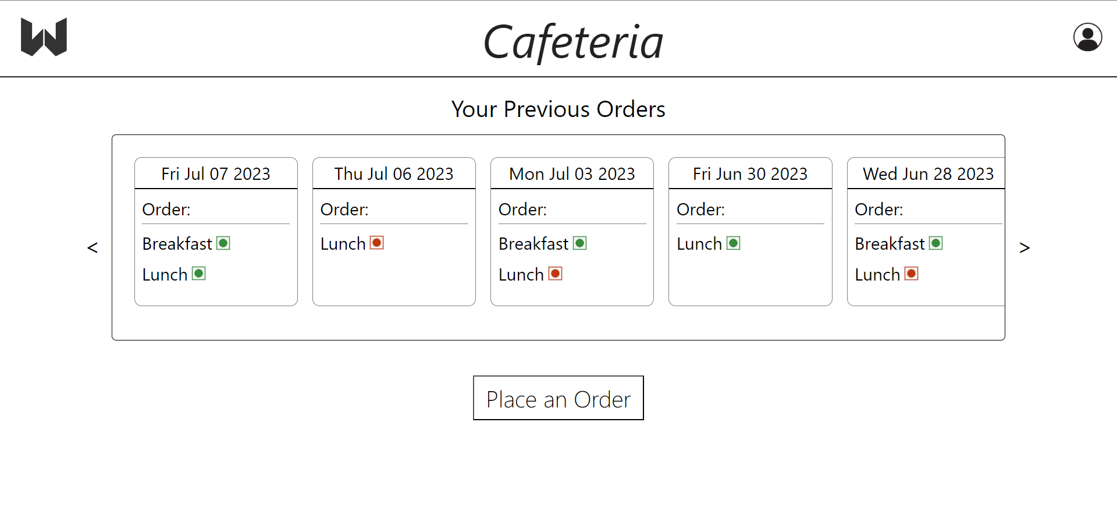
CAFETERIA

Slide 10
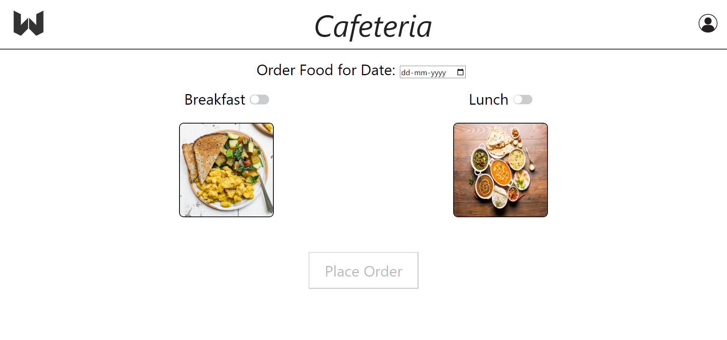
PLACE ORDER

Slide 11
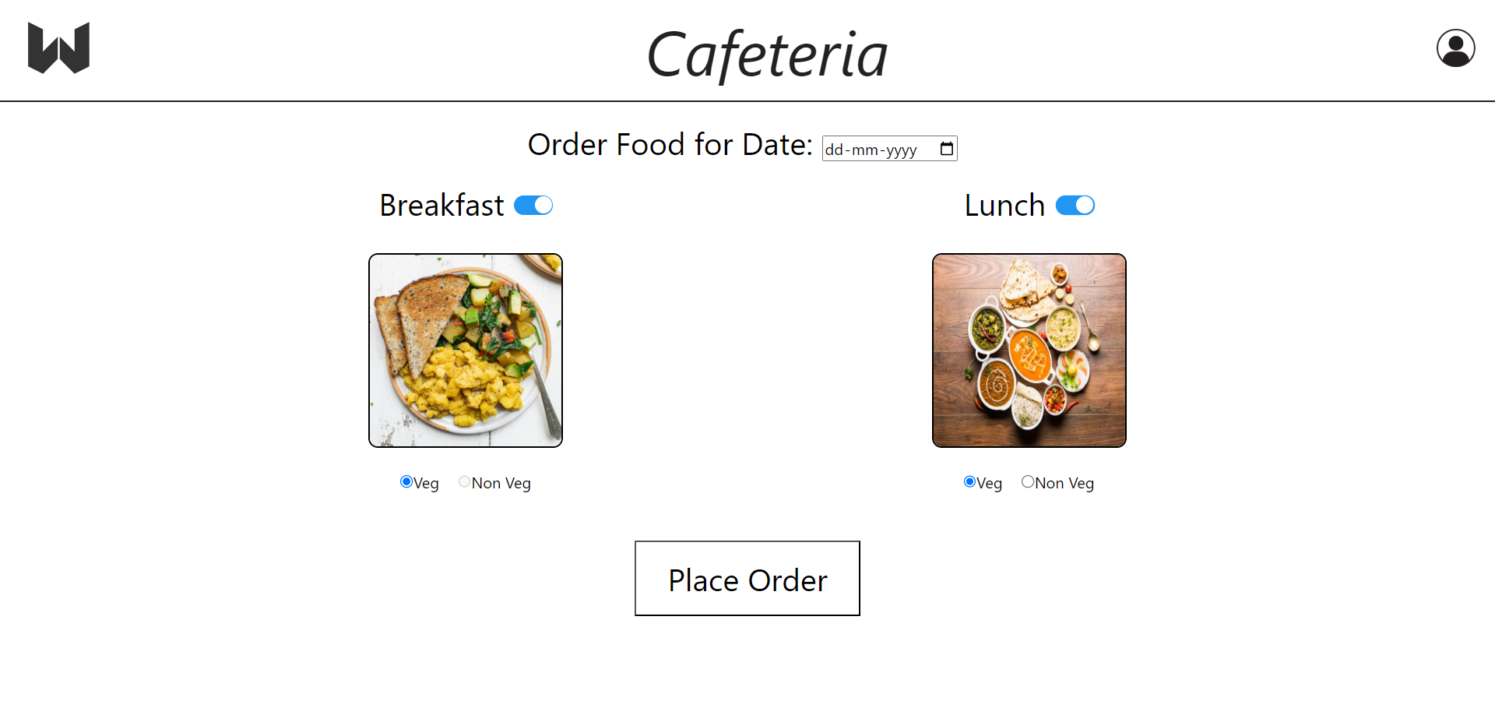
PLACE ORDER

Slide 12
Thank You..

